Slide 1
MSBA AI and Analytics Challenge Wisneyland Analysis
MacKenzie, Ann, Emaleigh
Wisneyland Analysis Competition

Slide 2
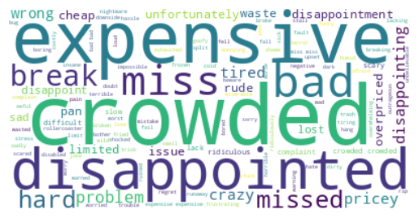
Methods
Findings
Word sentiment analysis
Word cloud
Low value in purchasing fast pass
The park is crowded (long lines for food, restrooms, rides, etc.)
High cost
Select Review:
"There is literally no space to walk especially as ride lines become extended and further block available walking space." Force people to make reservations (lottery if necessary) and reduce same day ticket sales entries. 'With rides closing down constantly (we had a stretch where we went to 4 rides consecutively with fast passes and each ride was closed down for repairs), lines weaving everywhere it was often very difficult to try to understand where the line actually started, long lines for food and bathrooms, etc.' I kept wondering why I had paid so much for this.'​
Wisneyland Analysis
Notes:
Emaleigh: For the methods, we did sentiment analysis using vader sentiment intensity analyzer to find the scores for the reviews. Scores were from -1 to 1 for and reviews were given a negative, neutral, positive, and compound score, which was the summarized metric. Negative sentiment in reviews and phrases are what we consider bad reviews for Wisneland, where customers are expressing their dissatisfaction about some aspect of the experience. Since we were tasked with finding low-hanging fruit solutions, we extracted the negative scores for each review to focus on solutions to improve customer satisfaction. From there we only focused on reviews that had a negative score in the top 15%, so these were the reviews where people were really upset. Then we generated a wordcloud seen on the right to identify the most common used words in these very negative reviews.
Next Ann will go over the areas of dissatisfaction that have some easy fixes to them.
Ann: Some things we noticed about the negative reviews were customers didn’t think the fast pass was work purchasing. They were very disappointed in the experience and didn’t meet their expectations for the price. Customers also noted crowdedness, where there was long lines for everything. Additionally, customers thought the tickets were too expensive and again their experiences didn’t meet the expectations they had especially at the price they paid.
To the left here is a select review listing off some of the issues this customer faced, which was very similar to other customer experiences.
Next Kenzie will go over the actionables that can be taken for these negative reviews.

Slide 3
Action Items
Multiple tiers of fast pass
Reservations (for rides, shows, attractions, mobile ordering)
Budget-friendly options (bundle deal, pamphlet guide)
Line activities (character visits, food vendors)
Wisneyland Analysis
Notes:
Kenzie: Based off of what Ann and Emaleigh mentioned, we have 4 main action items. First, we would like to introduce multiple tiers of fast passes where customers would, for example pay a lower price for a fast pass to only bypass a small part of the line, paying more if they want to completely cut the line. This could help solve the issue surrounding the value of the fast pass and the long lines. Second item would be to introduce reservations, where customers can book a time for rides, shows, different attractions, and restaurants. As well as mobile ordering for food, solving the long lines issue. Third, introducing some budget-friendly options such as a bundle deal for families, pamphlet guide showing the attractions, what to expect at each. The pamphlets could also help customers prioritize where they want to go, which could help with the crowds. Additionally, the budget friendly options could make customers feel like they are getting the full experience for the value, while reducing the high costs. The fourth item would be to introduce line activities such as character visits or food vendors. This could give the illusion to the customers that they didn’t wait in line that long, which would solve the long line issues.
Overall, these are our recommendations that would be easy and cost-effective to implement to improve overall customer experience and reviews at Hong Kong Wisneyland.

